Slide 1
SYSTEM
HOTEL
RESERVATION
Notes:
Hi
hello

Slide 2
Introduction
Database Management Systems (DBMS) are integral to the functionality of an Hotel Management Systems.
They provide a structured framework for storing and managing various types of data related to hostel operations.
With a DBMS, data can be organized, indexed, and retrieved efficiently, enabling quick access to information whenever needed.
This ensures data integrity, security, and facilitates easy scalability as the hostel grows.
It is an efficient way to store information about the tenants, room availability, payments so on all the other management related things.

Slide 3
Description Of the Project
1. Room Availability Search:
Users can search for available rooms based on their preferences, such as room type, check-in and check-out dates, and any additional criteria like price range or amenities.
2. Room Booking:
Once users find a suitable room, they can proceed to book it for specific dates.
3. Booking Management:
Users can view and manage their bookings through the system's interface.
4. Payment Handling:
Upon confirming a booking, users proceed to make payments securely through the system.
5. Customer Information Management:
The system maintains a centralized database of customer information, including personal details, contact information, and booking history.

Slide 4
6. Room Type Management:
The system provides features for managing room types, including defining different room categories (e.g., standard, deluxe, suite) and setting corresponding prices and availability.
7. Pricing and Availability Management:
The system dynamically manages room pricing and availability based on factors such as demand, seasonality, and promotional offers.
8. Reporting and Analytics:
The system generates comprehensive reports and analytics to track key performance indicators such as occupancy rates, revenue, booking trends, and customer satisfaction scores.
9. User Authentication and Security:
The system implements robust user authentication mechanisms to ensure secure access to sensitive information and functionalities.
10. Integration and Scalability:
The system is designed to integrate seamlessly with other hotel management systems, third-party APIs, or external services such as online travel agencies (OTAs) and payment gateways.

Slide 5
Description Of Tables
CREATE TABLE Customers (
CustomerID INT PRIMARY KEY,
FirstName VARCHAR(50),
LastName VARCHAR(50),
Email VARCHAR(100),
Phone VARCHAR(15)
);
CREATE TABLE Room (
RoomID INT PRIMARY KEY,
RoomNumber VARCHAR(10),
RoomType VARCHAR(50),
PricePerNight DECIMAL(10, 2)
);

Slide 6
CREATE TABLE Booking (
BookingID INT PRIMARY KEY,
CustomerID INT,
RoomID INT,
CheckInDate DATE,
CheckOutDate DATE,
FOREIGN KEY (CustomerID) REFERENCES Customers(CustomerID),
FOREIGN KEY (RoomID) REFERENCES Room(RoomID)
);
CREATE TABLE Payment (
PaymentID INT PRIMARY KEY,
BookingID INT,
Amount DECIMAL(10, 2),
PaymentDate DATE,
FOREIGN KEY (BookingID) REFERENCES Booking(BookingID)
);

Slide 7
CREATE TABLE RoomType (
TypeID INT PRIMARY KEY,
TypeName VARCHAR(50),
Description TEXT
);

Slide 8
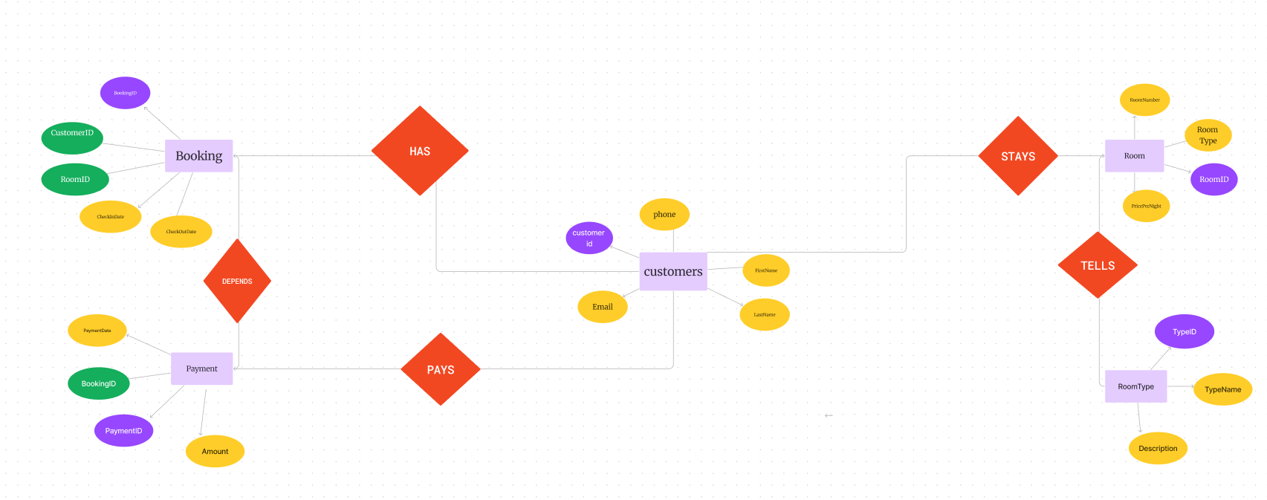
ER Diagram

Slide 9
NORMALISATION
Normalization is a series of tests that individual relational schemas go through to ensure that the database is normalized to avoid redundancy as much as possible. It is a process of organizing data in database.
Normalization plays a crucial role in the designing of efficient(GOOD) database schemas. It is in three forms
1). FIRST NORMAL FORM (1NF):
It is the test of the normalization process.
It ensures that the there are no multi-valued Attributes.
To Qualify this test, all columns should be atomic in nature(i.e.., No groups or arrays of attributes)
As we’ve seen before, there are no multi-valued attributes in the relations of our Database Schema. So it passes 1NF test.

Slide 10
2). SECOND NORMAL FORM (2NF):
It is the second test in the normalization process. It ensures that the relation has no partial dependency.
Partial dependency is functional dependency condition in which, despite the removal an attribute from Y, the FD Y->X holds. In other words, it is a condition in which a non-prime attribute depends on some prime attributes only, instead of depending on all prime attributes.
In our database schema, as all the relations have exactly one prime attribute, It passed 2NF test too.
3). THIRD NORMAL FORM (3NF):
It is the third test in the normalization process. It ensures that the relation has no transitive dependency.
Transitive Dependency is a functional dependency condition in which any two non-prime attributes involve in a functional dependency relationship.
In all the relations of the database schema, same kind of functional relationship can be observed i.e.., Y->X where Y is a single attribute which is the ID(primary key) and X is the set of all other attributes.
So this database schema passed 3NF test too.
With this, it marks the successful normalization process of the database schema.

Slide 11
DONE BY GROUP AP22110010067-B.THANMAI AP22110010070-M.AASRITHA AP22110010083-V.BHAGYA CSE-B

